Slide 1
Detecting Fake Job Posts using NLP
Team Members:
Amish Garg
Arja Raghuveer
Jonnada Vennela
Kemburu Satyavathi

Slide 2
📝 Problem Statement
Online job portals are widely used by millions of people, but unfortunately they also contain many fake and fraudulent job postings. These fake jobs mislead candidates, waste their time, and sometimes even result in financial loss or data theft.
Solution:NLP+Machine learning

Slide 3
📊 Data Collection
Source : Kaggle - https://www.kaggle.com/datasets/shivamb/real-or-fake-fake-jobposting-prediction (Fake_Job_Postings.csv)
Columns : job_id, title, location, department, salary_range, company_profile, description, requirements, benefits, telecommuting, has_company_logo, has_questions, employment_type, required_experience, required_education, industry, function, fraudulent.
Focus : Analyzing job posting data to identify key characteristics that distinguish fraudulent from legitimate opportunities.
Dropped rows with empty descriptions.
Dataset size : 17880 rows X 18 columns

Slide 4
📚 Libraries
Pandas
Re
BeautifulSoup
Nltk
Stopwords
word_tokenize
WordNetLemmatizer
Tabulate
Joblib
Train_Test_Split
TfidfVectorizer
LogisticRegression
RandomForestClassifier
Accuracy Score
Precision_Score
Recall_Score
F1_Score
Streamlit
Tabulate

Slide 5
🧹 Data Preprocessing
The dataset was loaded using pandas and all rows containing missing values were removed to ensure data quality.
Text data from the job descriptions was cleaned by removing HTML tags, converting to lowercase, and eliminating punctuation and numbers.
Natural Language Processing techniques such as tokenization, stopword removal, and lemmatization were applied usingNLTK.
The cleaned text was stored in a new column named final_text for each job posting, making it suitable for further analysis or model training.
The preprocessed dataset was saved as a new CSV file and a preview of the first 20 rows was displayed in a neatly formatted table.

Slide 6
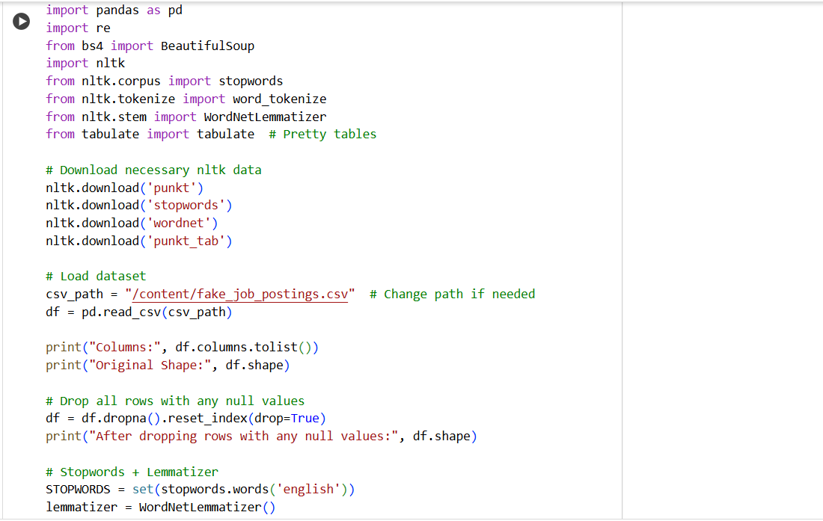
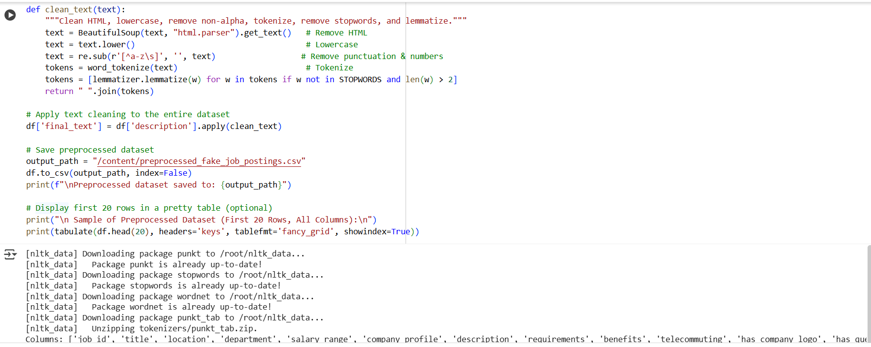

Slide 7
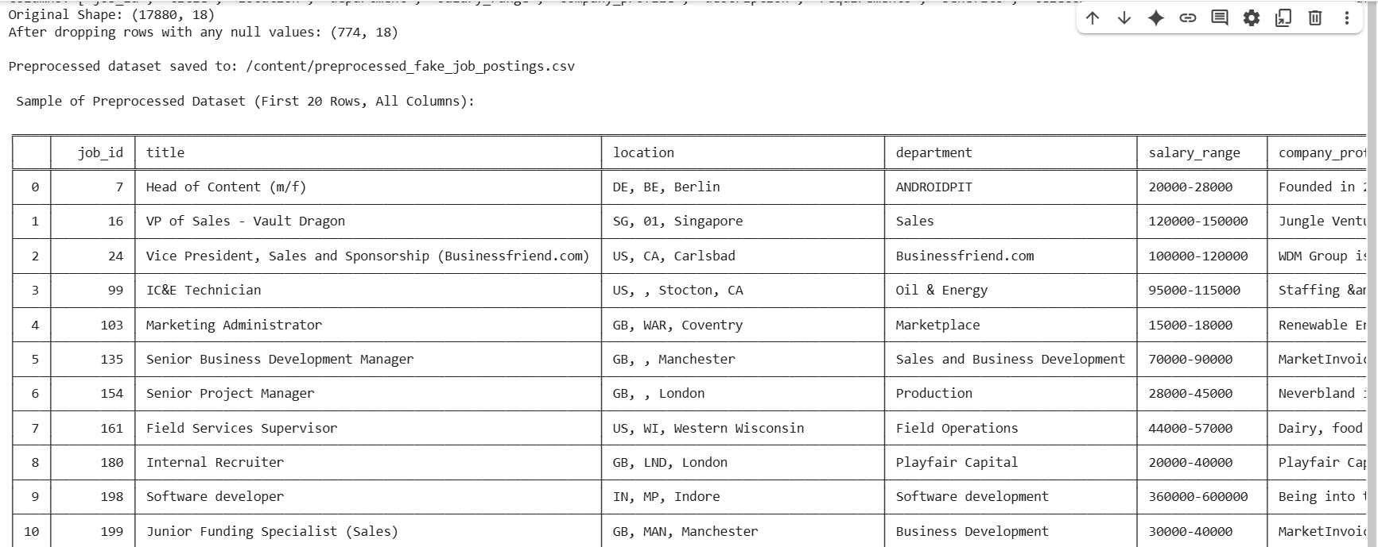

Slide 8
🤖 Train-Test Split
from sklearn.model_selection import train_test_split
Dividing a dataset into two distinct subsets:
Training Set : data is used to Train.
Testing Set : Evaluate the model on unseen data
The dataset was split into 80% for training and 20% for testing to evaluate the model on unseen data.
We used stratified splitting to maintain the same proportion of real and fake job postings in both training and test sets.

Slide 9
💻 Feature Extraction (TF-IDF)
from sklearn.feature_extraction.text import TfidfVectorizer
We used TF-IDF vectorization to convert job description text into numerical features suitable for machine learning.
The vectorizer was limited to the top 5,000 most frequent and important words to reduce complexity and focus on relevant terms.
Missing text entries were replaced with empty strings to ensure smooth vectorization without errors.

Slide 10
🔄 Model
from sklearn.linear_model import LogisticRegression
from sklearn.ensemble import RandomForestClassifier
Logistic Regression, a binary classification model, was used to predict whether a job posting is fraudulent or not by analyzing TF-IDF features.(0 or 1)
Random Forest Classifier was implemented as an ensemble method that combines multiple decision trees, offering robust performance and the ability to capture complex, non-linear patterns in the data.
Both models were evaluated using accuracy, precision, recall, and F1-score, and the one with the best overall performance was selected and saved for future use.

Slide 11
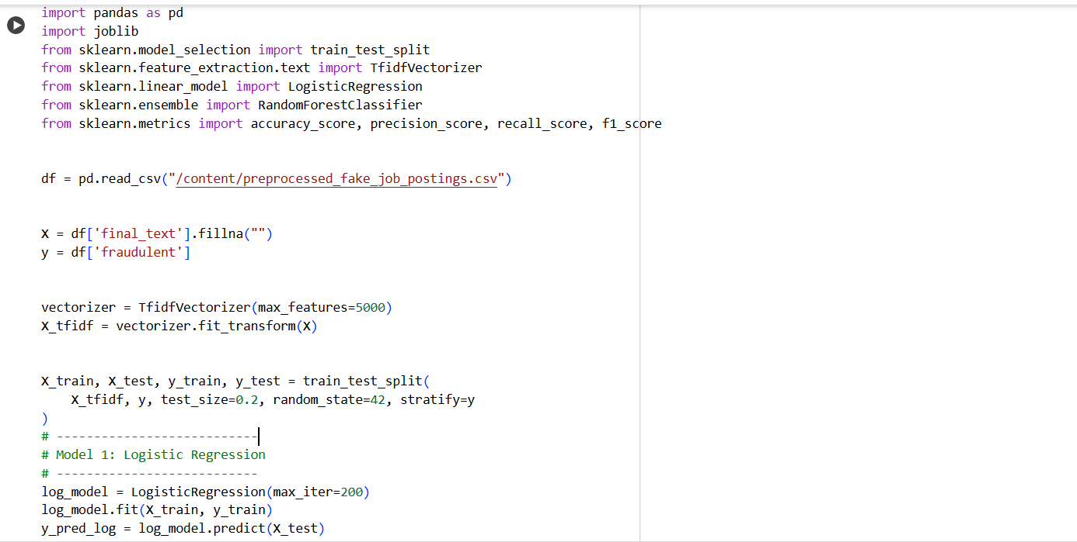

Slide 12
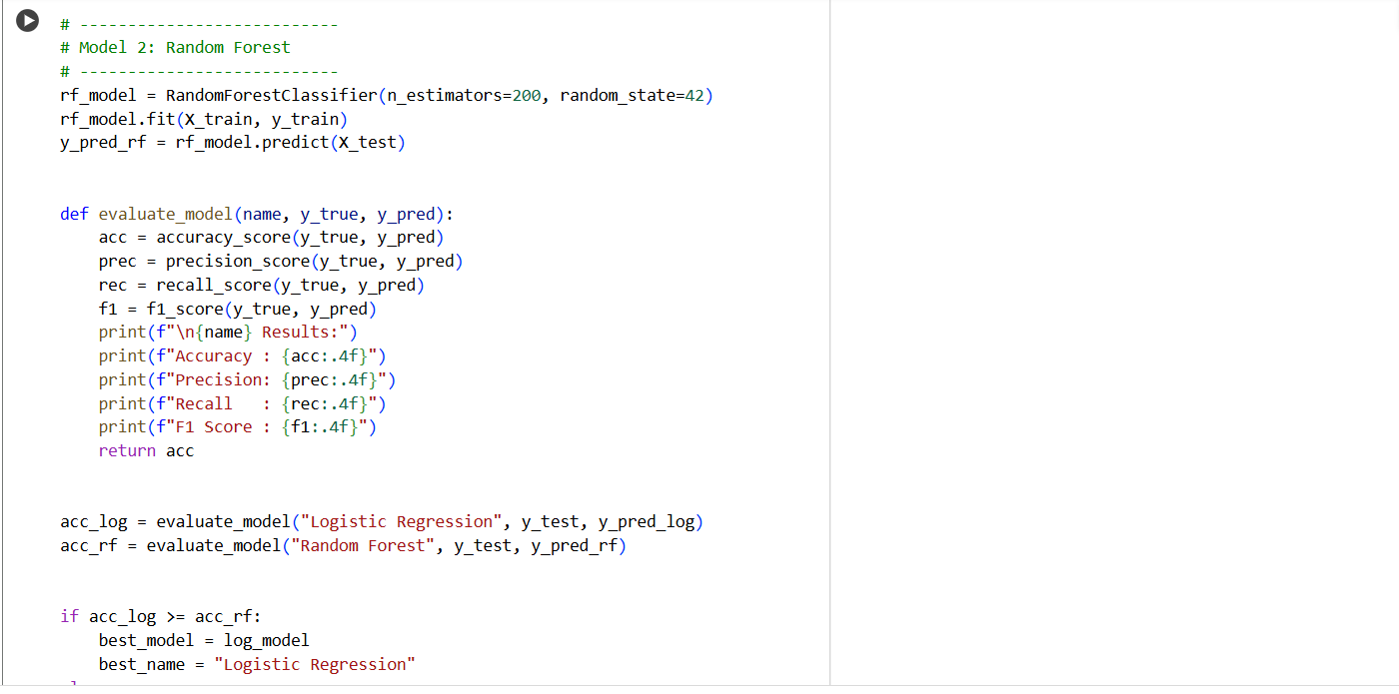
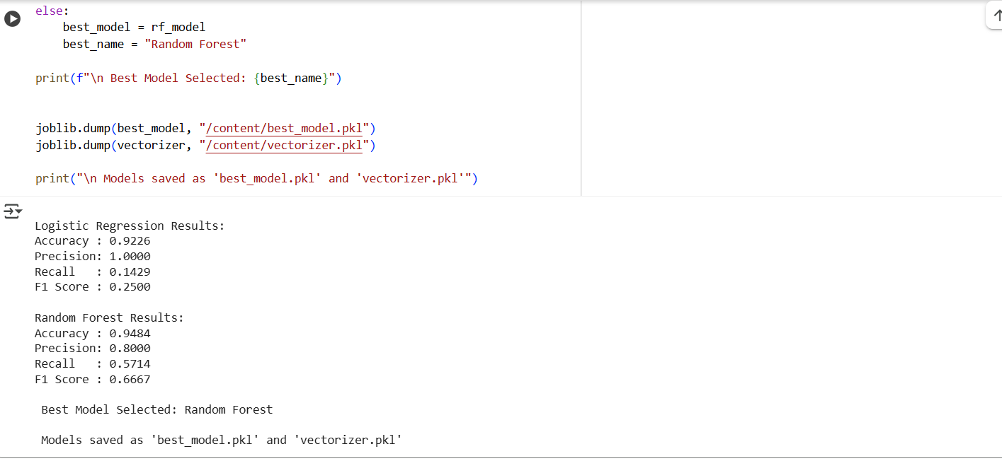

Slide 13
💻
Streamlit
the application is built using Streamlit, a Python framework that allows us to create interactive web apps with minimal code.
The input job description is first preprocessed using NLP techniques such as HTML tag removal, lowercasing, tokenization, stopword removal, and lemmatization.
A pre-trained machine learning model, along with a text vectorizer, is used to classify the cleaned job description and display the result with confidence.
Streamlit is used in this project because it allows fast and easy deployment of machine learning models with a user-friendly interface, without needing web development skills.

Slide 14
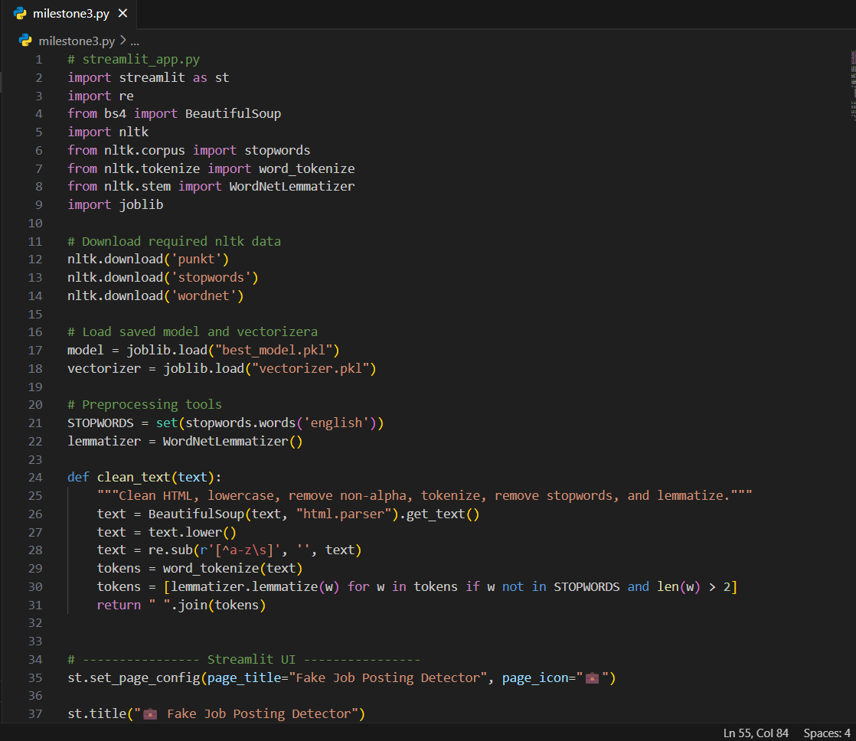

Slide 15
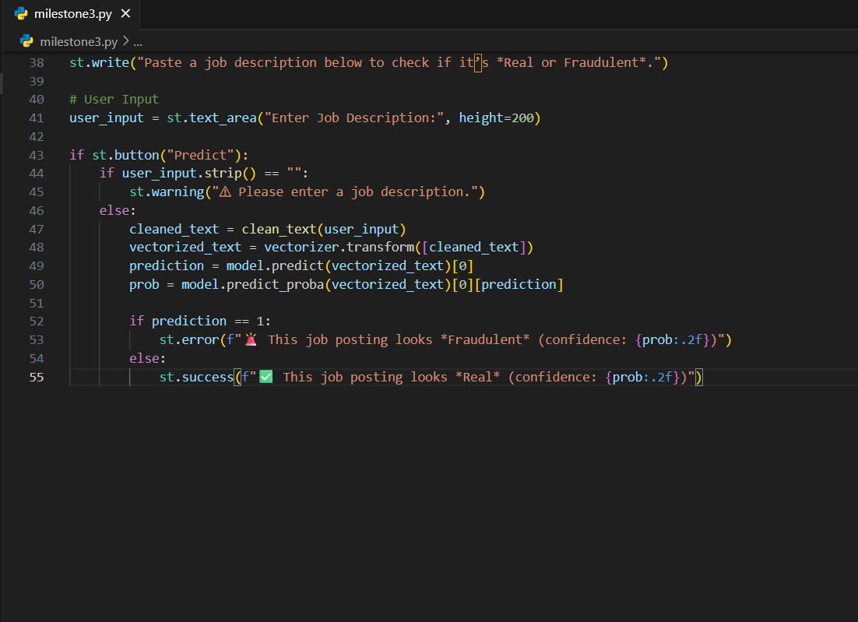
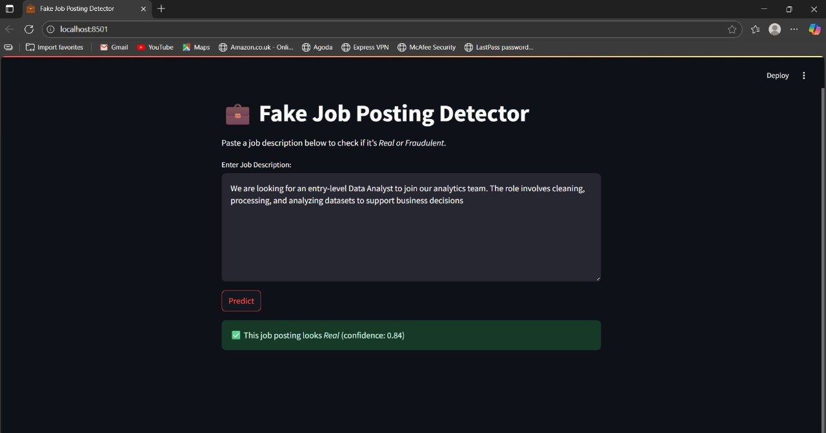

Slide 16
🔄
Retraining the Model with Feedback
Retraining the model with feedback is a crucial step in maintaining and improving the performance of a machine learning system over time.
As new data becomes available or users provide feedback on incorrect predictions, this information can be used to refine the model.
The model is then retrained on the updated dataset and evaluated using key performance metrics such as accuracy, precision, recall, and F1 score.
If the new model shows improved performance, it can replace the previous version in production.

Slide 17
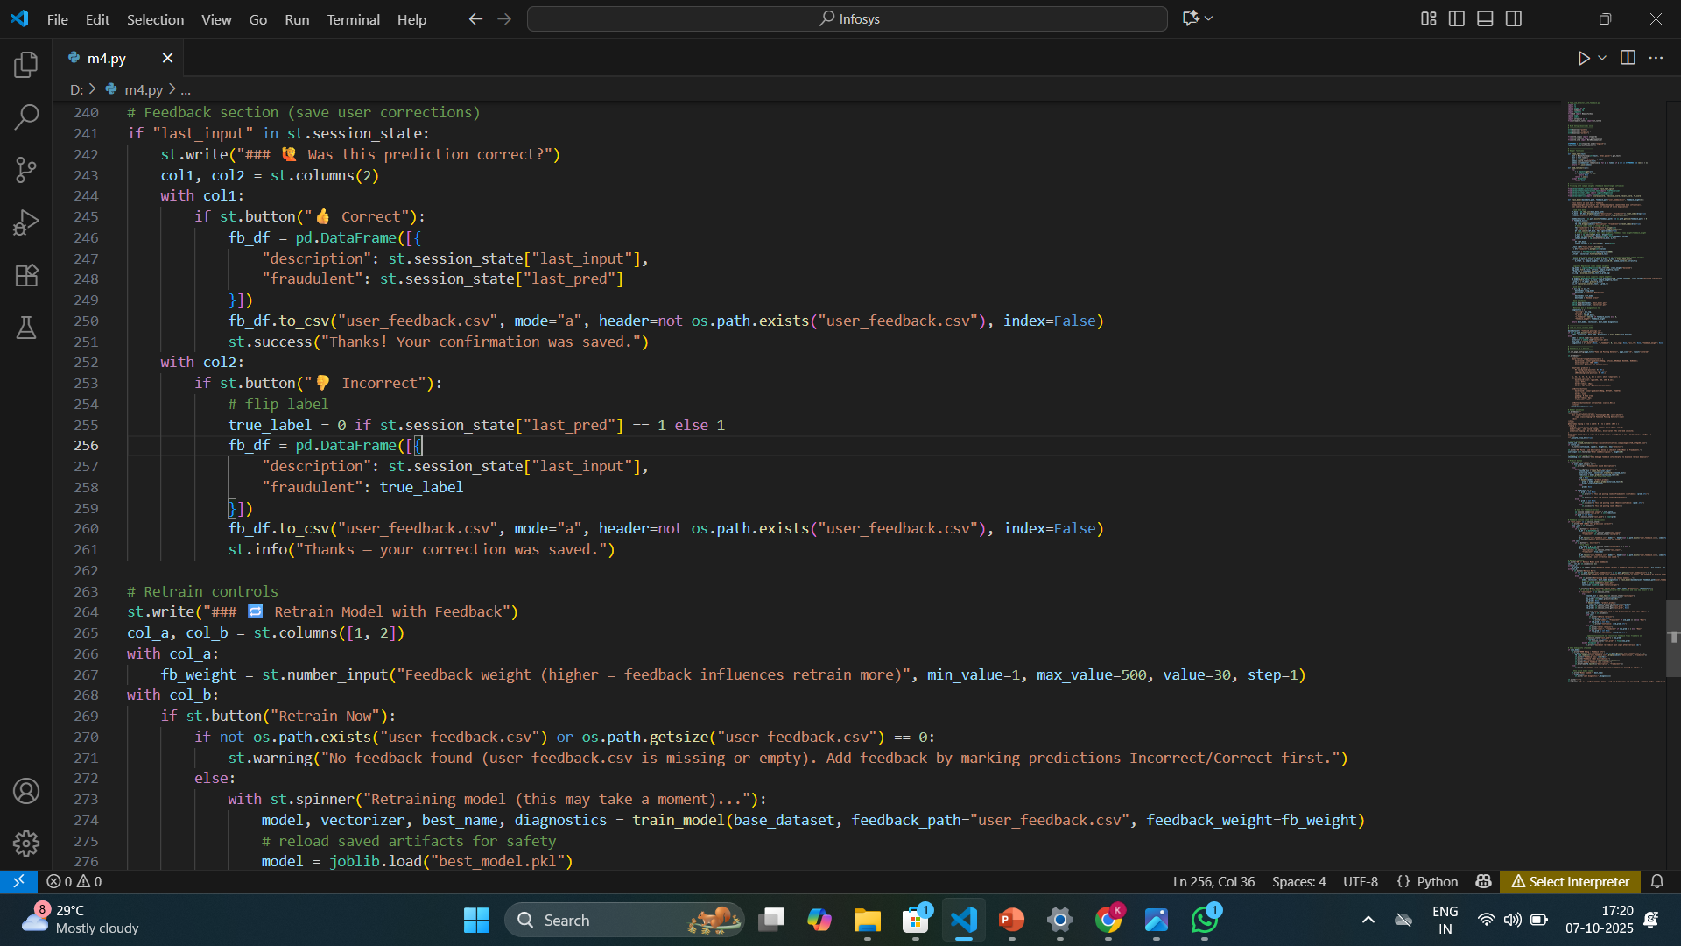

Slide 18
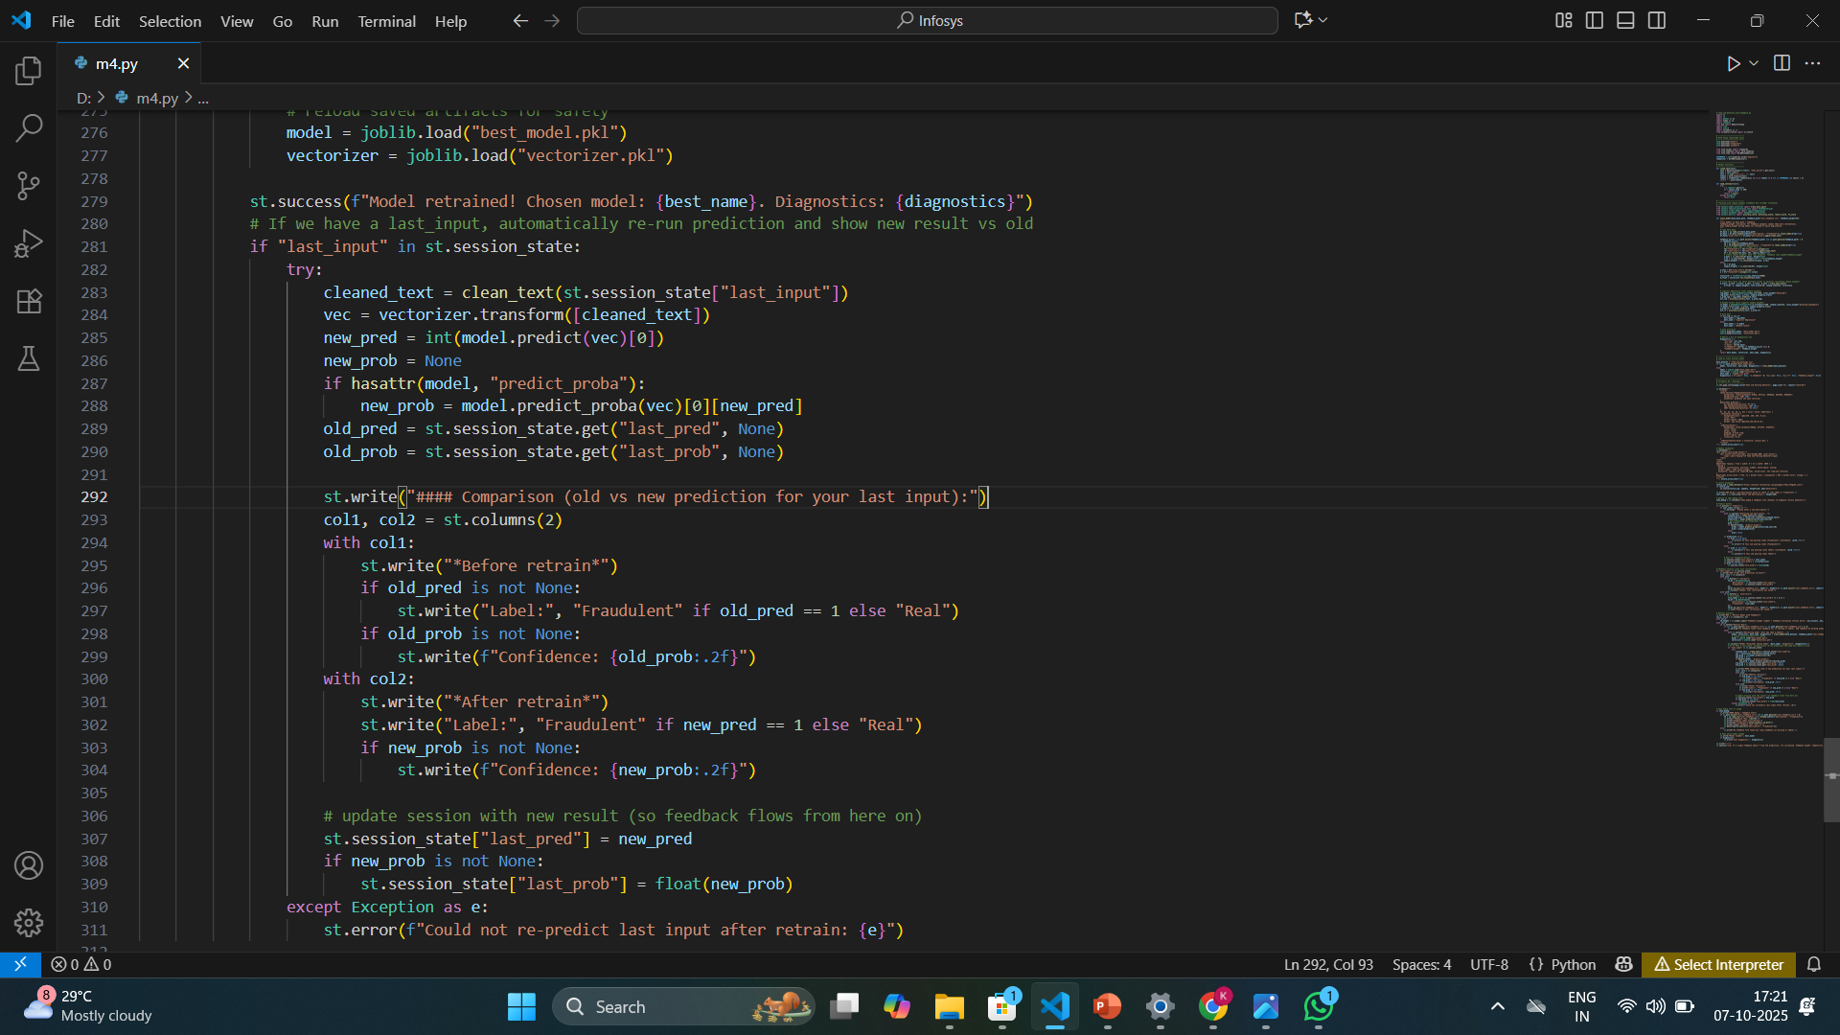

Slide 19
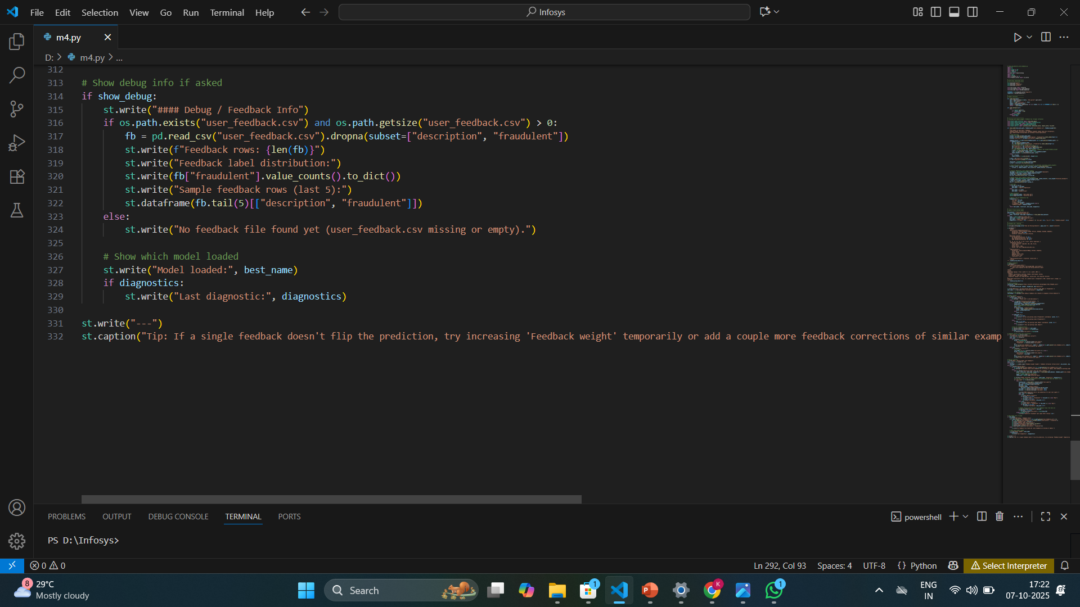
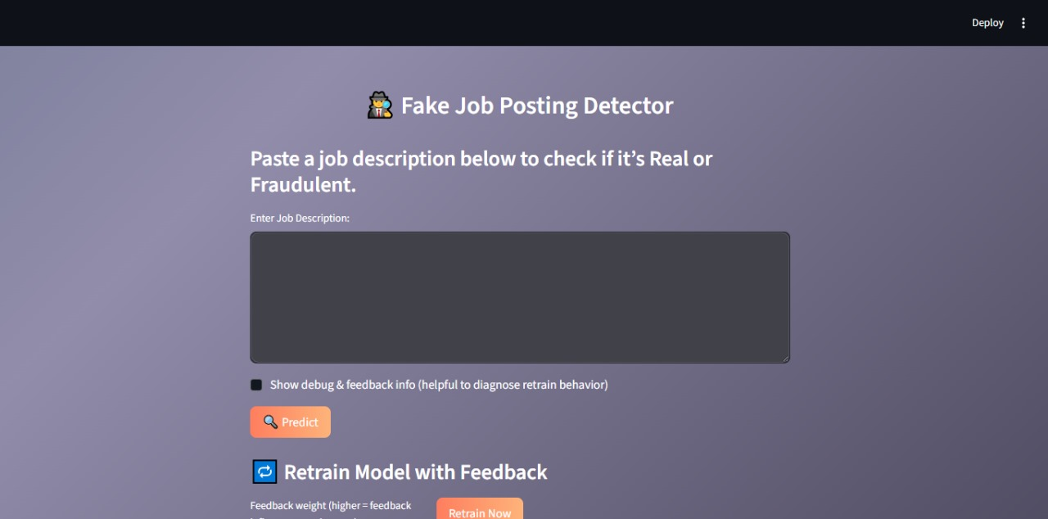

Slide 20
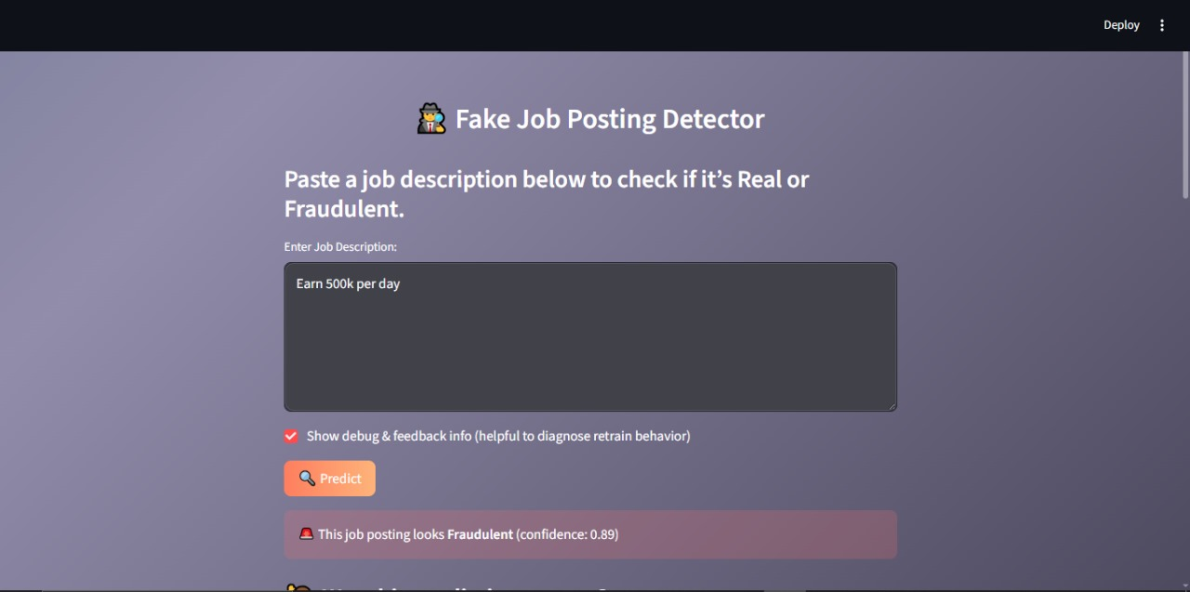
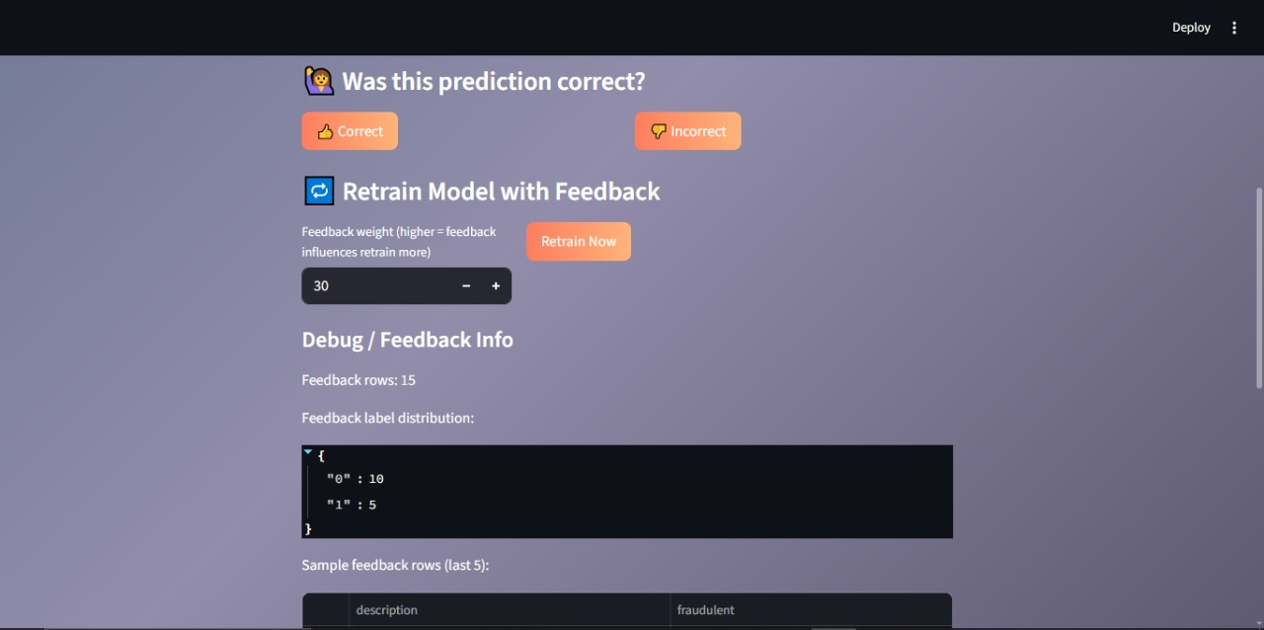

Slide 21
📝
Summary
Dataset → Data preprocessing → Cleaned job descriptions → TF-IDF → Logistic Regression, RandomForestClassifier → Streamlit → Retrain Model with Feedback.
Model detects fraudulent job postings.
Using Streamlit, we created a web app where users can paste a job description and instantly see the prediction result.
We use feedback in machine learning to continuously improve the model's accuracy and reliability.
GITHUB - https://github.com/amishgarg1/Milestone-4.git

Slide 22
THANK YOU
Amish garg
Arja Raghuveer
Jonnada Vennela
Kemburu satyavathi

